Slide 1


IBM University Engagement Project Submission

Slide 2


AI-Based Student Performance & Placement Prediction Using IBM Watsonx.ai
Domain: Artificial Intelligence & Machine Learning (AI/ML)
Submitted By - Kartik Bangar
Email ID - kartikbangar04@gmail.com
Contact - +91 9371120323
Department of Electronics & Telecommunication Engineering
MIT Academy of Engineering, Alandi, Pune

Slide 3
Problem Statement
INTRODUCTION
Educational institutions often face difficulties in identifying students who are likely to secure campus placements. Traditional evaluation methods mainly depend on academic performance and manual assessment, which are time-consuming and may not accurately reflect a student's placement potential. There is a need for an intelligent system that analyzes multiple student attributes and predicts placement outcomes using Artificial Intelligence.
Challenges
• Manual evaluation process
• Time-consuming analysis
• Lack of predictive insights
• Inconsistent decision making
• Difficulty identifying placement-ready students
-
01

Slide 4
Objectives
The primary objectives of this project are:
• Predict whether a student is likely to be placed.
• Analyze academic, technical, and communication-related attributes.
• Automate the prediction process using IBM Watsonx.ai AutoAI.
• Deploy the trained machine learning model on IBM Cloud.
• Assist educational institutions in improving placement preparation strategies.
02

Slide 5
System Architecture
Workflow
Student Dataset
IBM Cloud Project
IBM Watsonx.ai AutoAI
Data Preprocessing
Best Model Selection
Pipeline Comparison
Model Training
Feature Engineering
03
Cloud Deployment
Student Placement Prediction

Slide 6
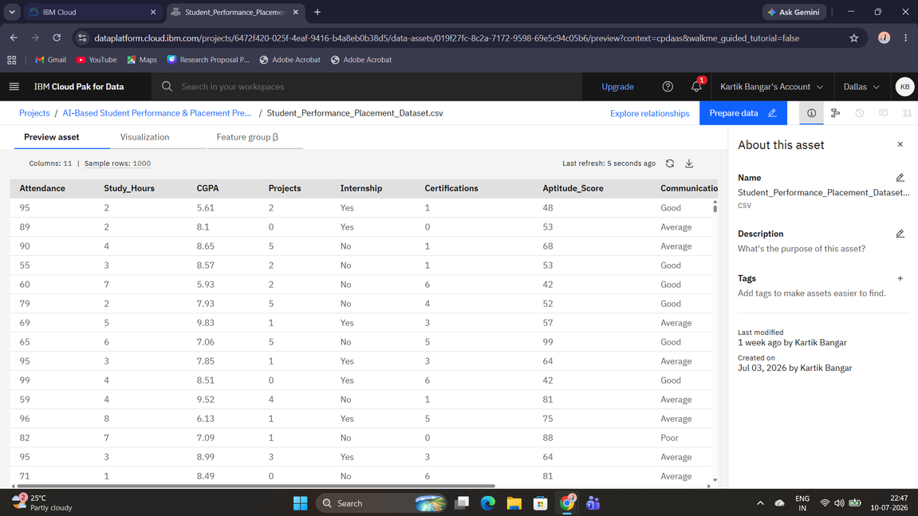
Dataset Description
The project uses a structured CSV dataset containing student academic and skill-related information.
Dataset Information
Dataset Format : CSV
Number of Records : 1000
Number of Features : 11
Prediction Column : Placement
Features Used
• Attendance
• Study Hours
• CGPA
• Projects
• Internship
• Certifications
• Aptitude Score
• Communication Skills
• Placement Status
04

Slide 7
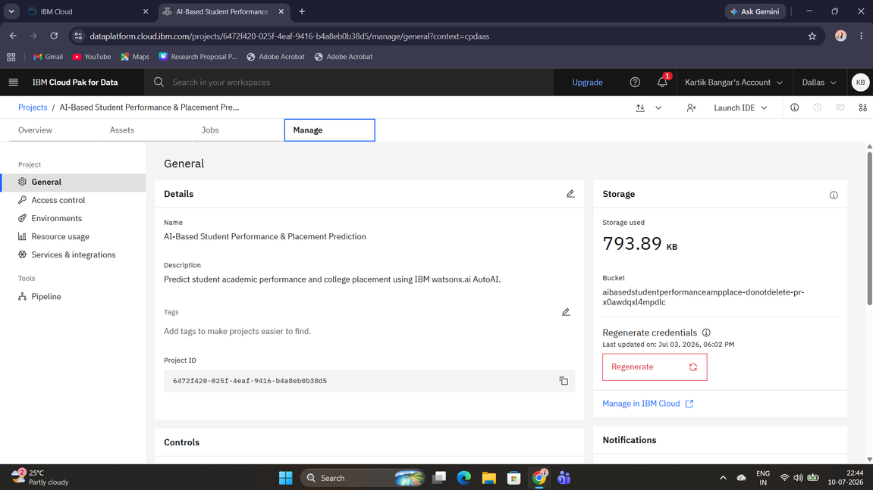
05
IBM Cloud Project
Activities Performed
Benefits
• Secure Cloud Environment
• Easy Dataset Management
• Integrated Machine Learning Services
• Created IBM Cloud Project
• Uploaded Dataset
• Configured IBM Watsonx.ai AutoAI
• Managed Project Assets
• Created Machine Learning Experiment
-

Slide 8
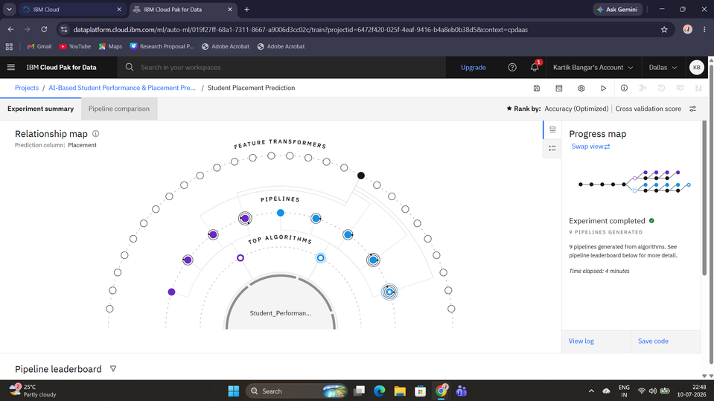
06
IBM Watsonx.ai AutoAI Experiment
IBM Watsonx.ai AutoAI automatically performs machine learning tasks such as data preprocessing, feature engineering, algorithm selection, hyperparameter optimization, and model evaluation.
AutoAI Process
• Data Preparation
• Feature Engineering
• Pipeline Generation
• Hyperparameter Optimization
• Model Comparison
• Best Pipeline Selection

Slide 9
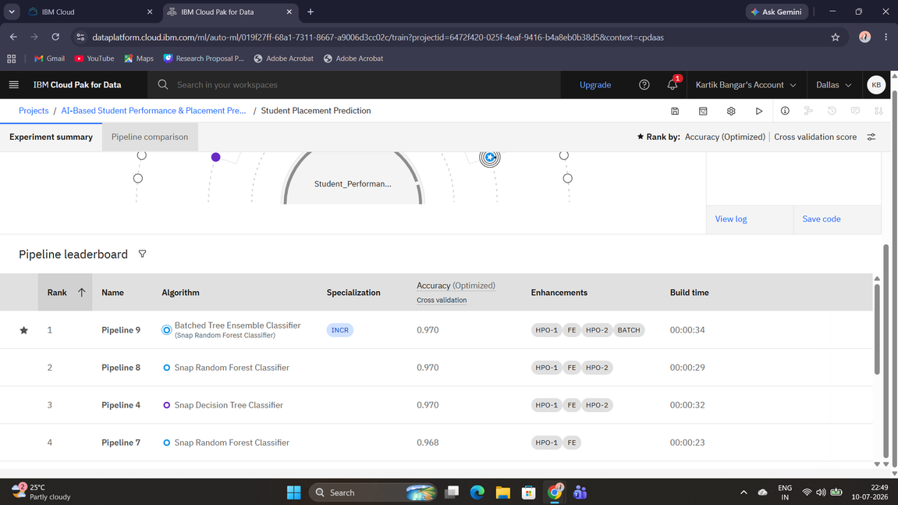
Pipeline Leaderboard
IBM Watsonx.ai generated multiple machine learning pipelines and ranked them according to prediction accuracy.
Best Pipeline
Pipeline Number : Pipeline 9
Algorithm : Batched Tree Ensemble Classifier
Cross Validation Accuracy : 97%
Specialization : Incremental Learning
Advantages
• High Accuracy
• Better Generalization
• Automatic Optimization
07

Slide 10
Model Accuracy
97%
Model Performance
Selected Machine Learning Model
Algorithm
Batched Tree Ensemble Classifier
Performance Highlights
• Excellent Prediction Accuracy
• Optimized Feature Engineering
• Low Prediction Error
• Reliable Classification Performance
08

Slide 11
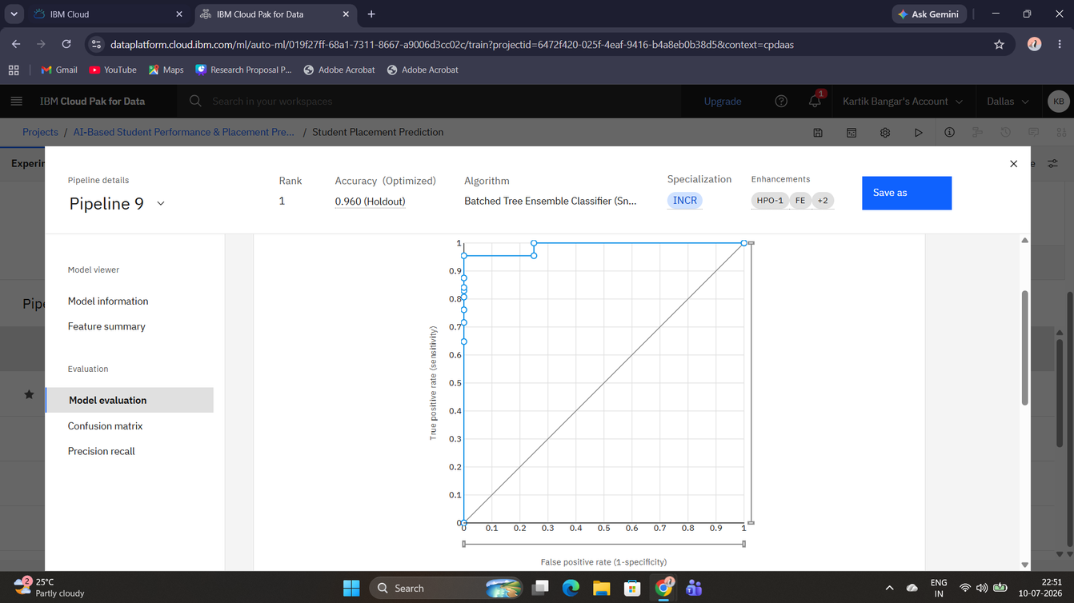
-
Model Evaluation
The trained model was evaluated using the Receiver Operating Characteristic (ROC) Curve.
Evaluation Metrics
• High True Positive Rate
• Low False Positive Rate
• Excellent Classification Capability
• Reliable Model Performance
09

Slide 12
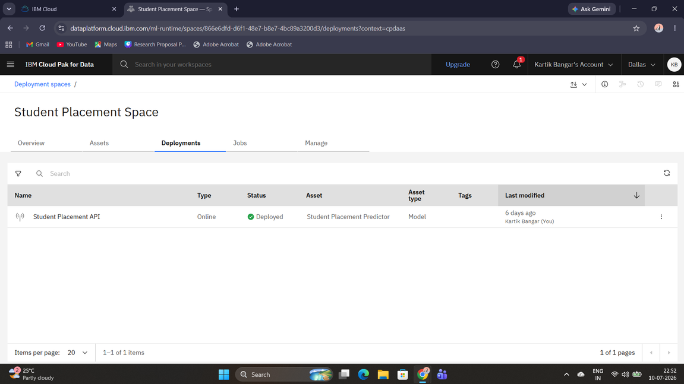
10
Model Deployment
The trained machine learning model was successfully deployed on IBM Cloud as an online deployment service.
Deployment Features
• REST API Generation
• Online Prediction Service
• Secure Cloud Deployment
• Real-Time Prediction

Slide 13
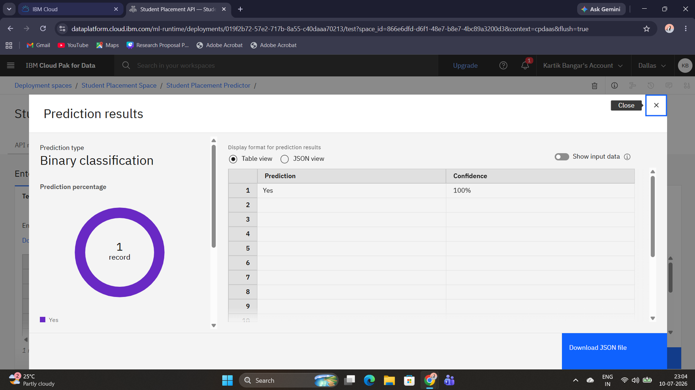
Prediction Results
The deployed model was tested using sample student records. The system successfully predicted the placement status with high confidence.
Prediction Output
Prediction : YES
Confidence : 100%
Benefits
• Instant Prediction
• High Confidence Score
• Easy Testing
11

Slide 14
Advantages & Applications
Advantages
• High Prediction Accuracy
• Automated Machine Learning
• Cloud-Based Deployment
• Fast Processing
• Easy to Use
• Reliable Results
Applications
• Colleges
• Universities
• Placement Cells
• Student Career Guidance
• Educational Analytics
12

Slide 15
Future Scope
The project can be enhanced further by integrating additional intelligent features.
Future Enhancements
• Resume Analysis
• Interview Performance Prediction
• Student Recommendation System
• Mobile Application
• Real-Time Dashboard
• Deep Learning Integration
• Integration with College ERP
• Personalized Career Guidance
13

Slide 16
Conclusion
This project successfully demonstrates the use of Artificial Intelligence and IBM Watsonx.ai AutoAI to predict student placement outcomes based on academic and skill-related parameters. The developed model achieved an accuracy of approximately 97% and was successfully deployed on IBM Cloud for real-time prediction. The system can assist educational institutions in identifying placement-ready students and improving placement strategies through data-driven decision-making.
14

Slide 17

GitHub Repository
The complete project files, documentation, dataset, presentation, and implementation screenshots are available in the public GitHub repository.
Repository Link
https://github.com/Kartik-Bangar/AI-Based-Student-Performance-Placement-Prediction
Repository Contents
• Project Presentation
• Project Report
• Problem Statement
• Student Performance & Placement Dataset
• IBM Cloud Implementation Screenshots
• Complete README Documentation
Repository Status: Public & Accessible
15

Slide 18
Thank You

